Slide 1
Physical Geography
12
Vocabulary
Days
Movement
Regions
Location
Human Environmental Interaction
Place
Learning Target: I can identify and describe climates and locations of major physical features of North, Central, and South America.
Success Criteria: I can explain:
I can identify and describe climates and locations of major physical features of a region.
I can explain how these physical characteristics impact settlement patterns
Bell Ringer:
Define the 5 vocabulary terms above.
5 Minutes
Collage is due daily!
Submit on Canvas

Slide 2
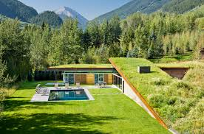
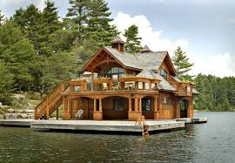
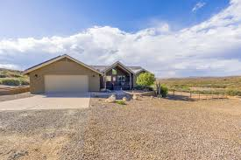
Mini Lesson
“If you had to pick one place to live, which would you choose and why? What challenges or benefits might you expect there?”

Slide 3
Cornell Notes Questions
The Five Themes
What does movement explain?
What are the unifying characteristics of a region?
Why do geographers study interactions?
What are the two types of location? Explain the difference between the two.
What does place include? Give an example.

Slide 4
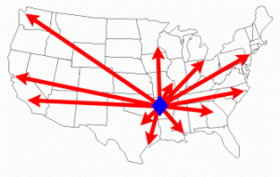
Movement
Explains how people, goods, and ideas move from one place to another.
Helps geographers understand cultural changes.

Slide 5
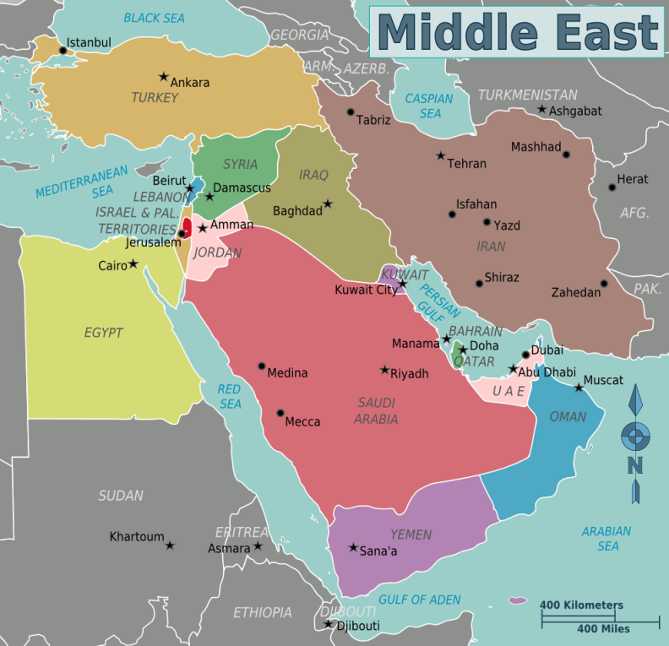
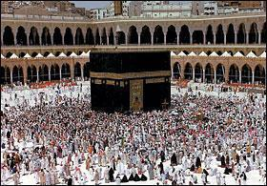
Regions
A region has a unifying characteristic, like climate, land, population, or history.
On maps, geographers use color and shape or special symbols to show regions.
Example: The Middle East, many of these countries are related to each other because of religion beliefs. Islam.

Slide 6
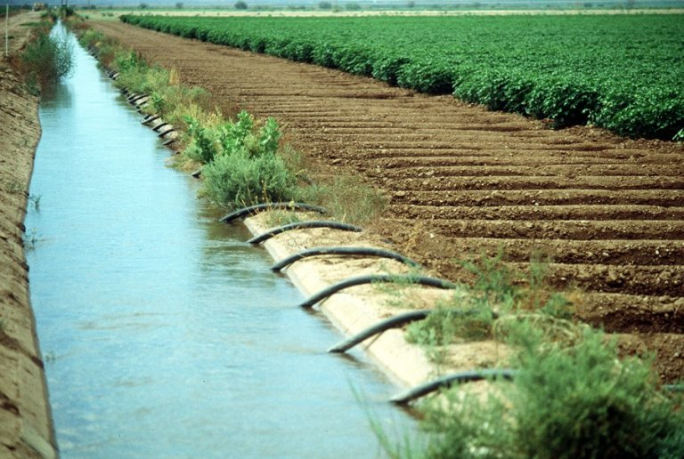
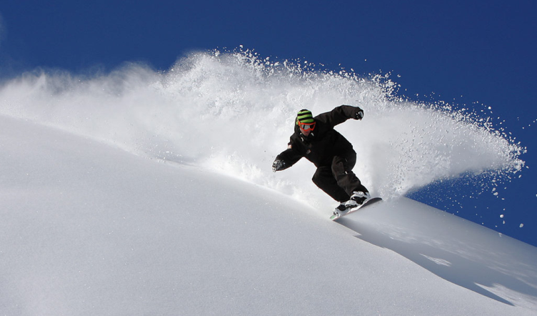
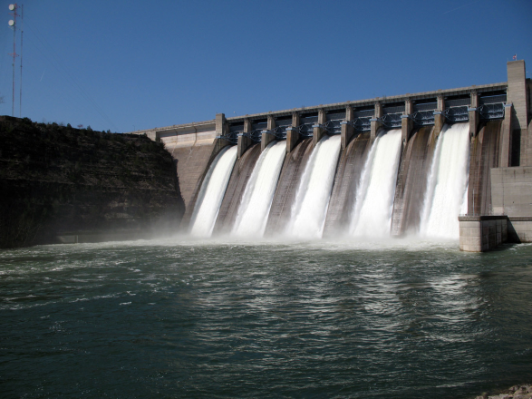
Human-Environment Interaction
How do people adjust to and change their environment? How does the environment adjust to and change the people?
Geographers also use interaction to study the consequences of people’s actions.
Divert water for crops
Play with snow on a mountain
Create power with a dam

Slide 7
Location
There are two ways to think about location:
  absolute location – describes the place’s exact position on the Earth.
  relative location – explains where a place is by describing places near it.

Slide 8
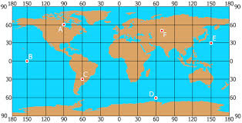
Absolute Location
describes the place’s exact position on the Earth
A= 60°N, 90°W
B= 0°, 150°W
C= 30°S, 60° W
D=60°S, 60°E
E= 30°N, 150 E
F= 50°N, 70°E

Slide 9
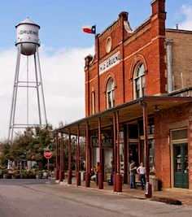
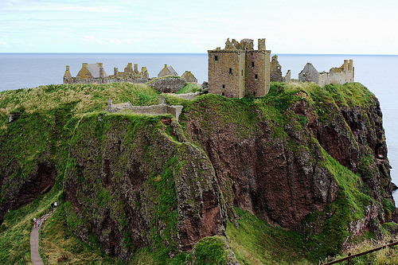
Relative Location
explains where a place is by describing places near it
The Storefront is across the street from the water tower.
The castle by the Cliffside.

Slide 10
Place
This includes a location’s physical and human features.
  To describe physical features, you might say that the climate is hot or cold or that the land is hilly.
  To describe human features, you might discuss how many people live there, what types of work they do, or what they do for fun.

Slide 11
Assignment: Due Today!!!!!!
  The Task:
  You will be creating a collage (a series of pictures and/or drawings that tells a story or follows a common theme) that explains the Five Themes of Geography in a place that you are familiar with. You need to be fairly familiar with your place because you will need to classify each part of your place within the 5 Themes. Common places you might want to choose are your own home, a cabin or resort you visit, grandma and grandpa’s house, a camp, or any place that is special to you and your life. Please be creative and think about you location choice, so you don’t get stuck! Have fun and good luck. Please follow the checklist below in order to receive the grade you are looking for.

Slide 12
Assignment: Due Today!!!!!
❏ Platform: Create your project using PowerPoint or another platform that allows voice-over presentations (e.g., Google Slides with recording, Canva, Prezi).
❏ Slides Requirements:
Title Slide:
  Include the presentation title.
  Include your name (author).
  Include the date.
Content Slides:
  Create a slide representing each of the Five Themes of Geography:
The slide must include:
  A clear label/title of the theme.
  At least one relevant picture representing that theme.
  A brief description or explanation of the theme.
  Pictures and text must be neatly arranged (avoid clutter).
❏ ❏ Visuals:
  Use five or more pictures that clearly correspond to the five themes.
  Label each picture or use captions to explain how it relates to the theme.
❏ Voice-Over:
  Add a voice-over narration explaining each slide clearly.
  Speak slowly and clearly, giving enough information about the theme and the picture.
❏ Formatting and Neatness:
  Keep slides clean and organized.
  Use readable fonts and sizes.
  Maintain a consistent color scheme and style throughout the presentation.
❏ Final Check:
  Review your presentation for spelling and grammar.
  Make sure the voice-over is audible and clear.
  Confirm all slides have the required elements (title, author, date on title slide; theme label, picture, description on content slides).

Slide 13
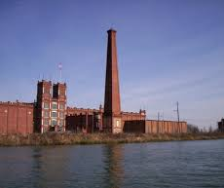

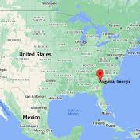
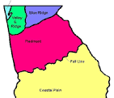
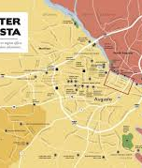
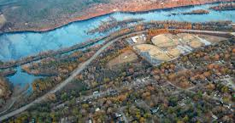
Augusta, Georgia
5 Themes Project
By Ms. Parks
08/15/2025
Region
Interaction
Location
Location
Place
Movement

Slide 14
Physical Geography
12
Vocabulary
Days
Movement
Regions
Location
Human Environmental Interaction
Place
Learning Target: I can identify and describe climates and locations of major physical features of North, Central, and South America.
Success Criteria: I can explain:
I can identify and describe climates and locations of major physical features of a region.
I can explain how these physical characteristics impact settlement patterns
Bell Ringer: Label as many major physical features as they can in 3 minutes.
Collage is due daily!
Submit on Canvas

Slide 15
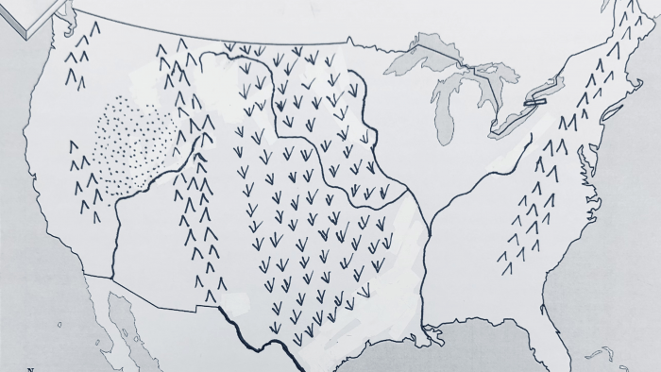

Slide 16

North American Physical Features
Students will create a collage (a series of pictures and/or drawings that tells a story or follows a common theme) that explains key physical features of North America.

Slide 17
Assignment: Due Today!!!!!
❏ Platform: Create your project using PowerPoint or another platform that allows voice-over presentations (e.g., Google Slides with recording, Canva, Prezi).
❏ Slides Requirements:
Title Slide:
  Include the presentation title.
  Include your name (author).
  Include the date.
Content Slides:
  Create a slide representing each of the Five Themes of Geography:
The slide must include:
  A clear label/title of the theme.
  At least one relevant picture representing that theme.
  A brief description or explanation of the theme.
  Pictures and text must be neatly arranged (avoid clutter).
❏ ❏ Visuals:
  Use five or more pictures that clearly correspond to the five themes.
  Label each picture or use captions to explain how it relates to the theme.
❏ Voice-Over:
  Add a voice-over narration explaining each slide clearly.
  Speak slowly and clearly, giving enough information about the theme and the picture.
❏ Formatting and Neatness:
  Keep slides clean and organized.
  Use readable fonts and sizes.
  Maintain a consistent color scheme and style throughout the presentation.
❏ Final Check:
  Review your presentation for spelling and grammar.
  Make sure the voice-over is audible and clear.
  Confirm all slides have the required elements (title, author, date on title slide; theme label, picture, description on content slides).

Slide 18
Physical Geography
12
Vocabulary
Days
Movement
Regions
Location
Human Environmental Interaction
Place
Learning Target: I can identify and describe climates and locations of major physical features of North, Central, and South America.
Success Criteria: I can explain:
I can identify and describe climates and locations of major physical features of a region.
I can explain how these physical characteristics impact settlement patterns
Bell Ringer: “How might the climate of a place affect the way people live, the jobs they do, or the food they eat?”
Collage is due daily!
Submit on Canvas

Slide 19
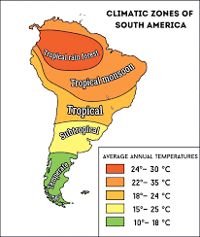

Slide 20
South America Physical Features
Students will create a collage (a series of pictures and/or drawings that tells a story or follows a common theme) that explains key physical features of South America.

